Slide 1
Data Analytics Capstone Project
By: Mohamed Soliman
Dhara Patel

Slide 2
Supermarket sales
Dataset and Questions for Analysis
Mission Statement and Stakeholder Analysis
Critical information of capstone

Slide 3
Dataset and Mission Statement
Here, is the link for dataset, supermarket_sales - Sheet1
Dataset: Supermarket sales data with 1,000 rows and 17 columns, including customer demographics, product sales, pricing, and ratings.
Data Quality: The data has been checked for duplicates and missing values. Dates and numeric values have been confirmed properly.
Format: The data is in a CSV file and has been processed using Python for analysis
Date and time columns are in string format and need conversion.
Some values may require normalization or aggregation for deeper insights.
To provide actionable insights and comprehensive analysis of supermarket sales data to enable better decision , improve customer experience, and drive business growth through evidence-based strategies.

Slide 4
Questions for Analysis
Sales Performance:
What is the total revenue generated?
Which branch or city has the highest sales?
What is the average transaction value?
Customer Insights:
How do sales differ between "Member" and "Normal" customers?
Product Line Analysis:
Which product line generates the most revenue?
What is the average rating per product line?
Time Based Trends:
Which day or time has the highest sales?
Are there seasonal patterns in sales?
Payment Preferences:
What is the most common payment method?
Does payment method preference vary across cities or branches?
Profitability:
Which branch or product line is the most profitable?
What is the relationship between quantity sold and gross income?

Slide 5
Stakeholder Analysis
Business Owners/Executives
Needs: Insights on revenue, profitability, and sales trends to shape strategic decisions.
Expectations: Clear and actionable data insights.
Store Managers
Needs: Branch-specific sales performance and customer feedback to optimize operations.
Expectations: Detailed performance metrics by location and time for effective management.
Marketing Team
Needs: Understanding of customer demographics, preferences, and purchasing behavior.
Expectations: get customer data and sales trends to design targeted campaigns.
Inventory and Supply Chain Teams
Needs: Trends in product demand to plan inventory and logistics.
Expectations: Accurate forecasts of product demand across product lines.

Slide 6
Plan to Prepare Data for Analysis:
Plan:
Data Cleaning
Convert date and time columns into proper datetime format.
Validate numerical columns for outliers or inaccuracies (e.g., Rating or Total).
Data Transformation
Create derived metrics like monthly revenue or sales by customer type.
Categorize Time into periods (morning, afternoon, evening) for trend
Data Organization
Cut data into relevant groups ( branch, product line, or payment method).
Use pivot tables or summarized tables for ease of reporting.
What We’ll Analyze:
Sales trends across branches and product lines.
Customer behavior by gender, customer type, and payment method.
Ratings to identify satisfaction levels.
How We’ll Present It:
Create visualizations like bar charts and trend lines to make the findings easy to understand.

Slide 7
Relationship Between Data and Organizational Needs:
Sales Performance: Revenue data aligns with business owners' needs to measure growth and profitability.
Customer Insights: Gender, customer type, and payment method analysis supports targeted marketing strategies.
Operational Efficiency: Product demand trends guide inventory management.
Branch Evaluation: Branch-level data helps managers optimize regional performance.

Slide 8
Evidence of Critical Thinking and Analysis:
Understanding Patterns
Analyzing sales trends across time to identify peak periods.
Assessing the profitability of product lines and payment methods.
Data-Driven Decisions
Identifying high-demand product lines for focused marketing.
Detecting underperforming branches or products to implement corrective actions.
Customization and Insightful Recommendations
Splitting customer types (Members vs. Normal) to determine loyalty program effectiveness.
Correlating Rating with other variables to improve customer satisfaction.

Slide 9
Project Scope Statement
What We Plan to Accomplish:
Analyze sales trends across different branches, cities, and product lines.
Evaluate customer demographics, such as gender and customer type, to understand buying behavior.
Assess financial metrics, including gross income, gross margins, and sales revenue.
Look at the relationship between payment methods and customer preferences.
Analyze customer ratings to identify factors affecting satisfaction.
Develop visualizations to present insights on sales and customer trends effectively.
What We Will Not Address:
Predictive modeling or forecasting of future sales trends.
Analysis of external influences ( economic or seasonal factors) on sales.
Examination of detailed inventory or supply chain operations.
Implementation of recommended changes to operations or strategy.

Slide 10
Audience Needs:
Intended Audience: Store managers, marketing teams, and operational decision-makers.
Audience Goals:
Gain insights into branch and product line performance.
Understand customer purchasing behavior and preferences.
Identify key factors influencing customer satisfaction.
Develop strategies to enhance revenue and customer experience.
Analysis Plan:
Perform descriptive statistics using Python to calculate total sales, average sales, and branch performance.
Create visualizations like bar charts to highlight trends in product line sales and customer behavior.
Use the analysis to summarize customer demographics and ratings.

Slide 11
Demonstrate critical thinking and considered the risks and rewards of the project.
Risk: Insights might be limited due to the dataset size or the scope of the project.
Reward: The analysis will provide actionable recommendations for improving revenue, product management, and customer satisfaction.
Critical thinking:
By analyzing patterns and trends, we aim to identify areas for growth, such as high-demand product lines or underperforming branches. These insights will guide better business decisions and improve customer satisfaction.

Slide 12
Detailed written business proposal

Slide 13
Detailed written Proposal Content
Client: Supermarket superstore chain operating across cities, seeking insights for growth.
Branches
Analyze branch performance to optimize high-revenue locations operations and address low performers
Marketing
Study customer behavior to enhance loyalty by creating Create targeted campaigns based on customer segmentation
Inventory
Evaluate product line profitability for better inventory management and Reduce waste and improve inventory efficiency

Slide 14
Analysis Priorities
Execution Plan
Data Collection: Organize and load transaction data.
Data Cleaning: Address missing values, duplicates, and formatting.
Data Analysis: Use Python (pandas, matplotlib) for insights and Excel for visuals.
Reporting: Deliver actionable recommendations with clear visuals.
Branch and City-Level Sales Trends
Highest revenue impact.
Customer Segmentation
Focus on membership, and payment preferences
Product Line Performance
Evaluate profitability and customer satisfaction

Slide 15
Client Overview
Mission Statement: provide actionable insights to optimize branch performance, customer behavior, and product profitability for sustained growth
Client: A supermarket chain operating across multiple branches and cities
Objective: To improve sales forecasting, customer segmentation, and operational efficiency by analyzing sales and customer data.
Purpose and Benefits
Goals:
Identify sales trends and customer behavior.
Enhance inventory management and targeted marketing.
Maximize profits and customer satisfaction.
Benefits:
Reduced stock issues.
Improved customer loyalty and revenue growth.

Slide 16
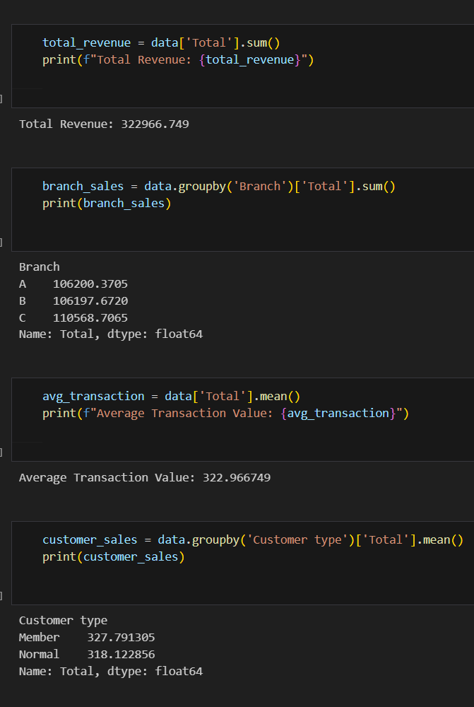
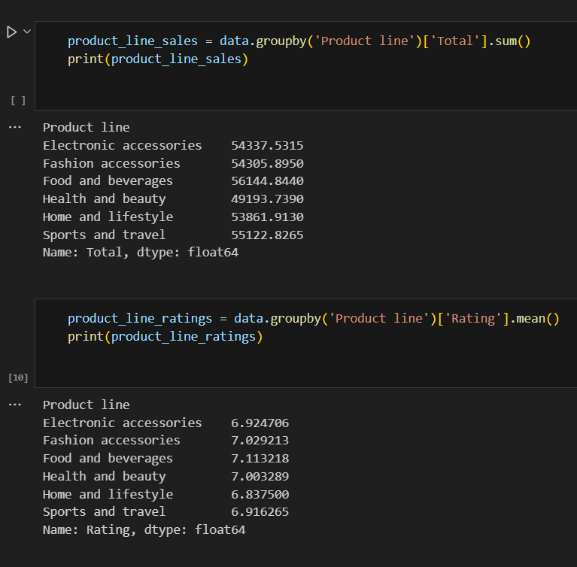
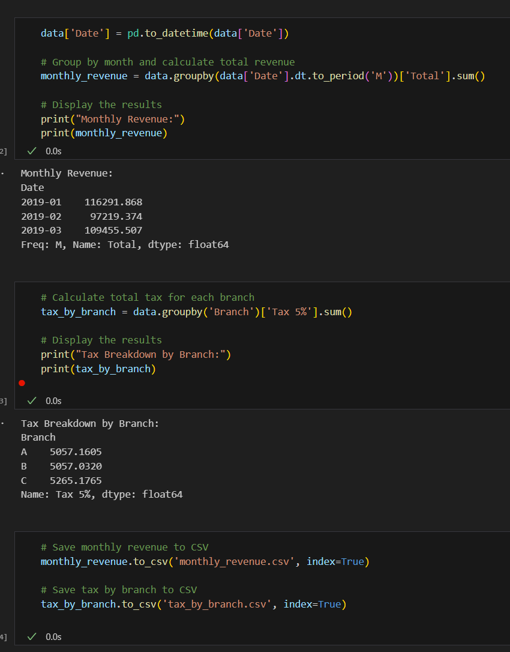
Python

Slide 17
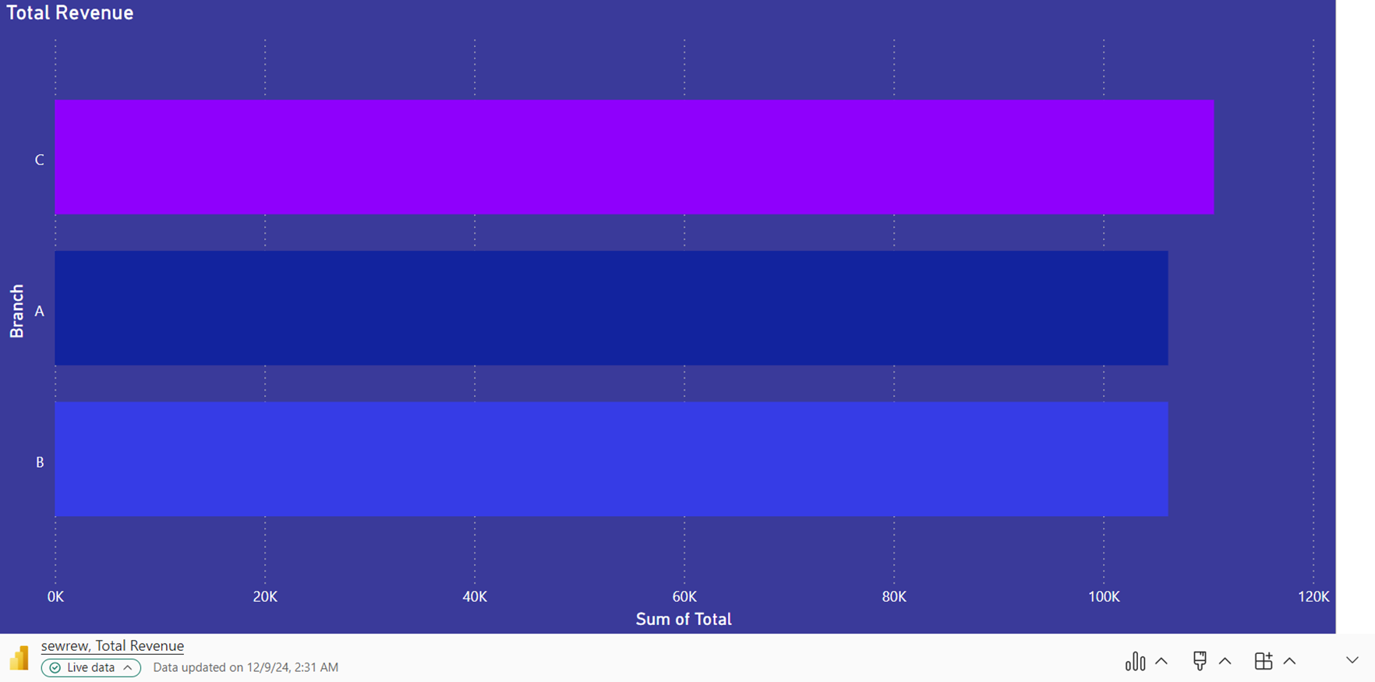
Branch Performance Analysis
Branch performance analysis revealed significant revenue differences among locations. Branch C leads in revenue generation with $110,568, while Branch A shows the lowest performance at $106,200.
Branch C leads revenue with $110,568
Branch A underperforms with $106,200

Slide 18
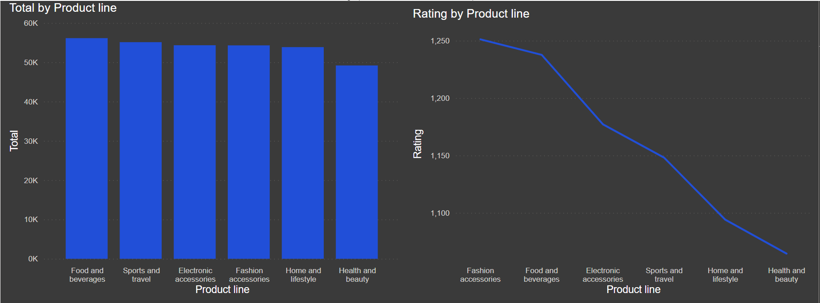
Product performance analysis
Food and Beverages generate the highest revenue at $56,144.
Sports and Travel products receive the lowest average customer ratings of 6.91.
Recommendations
Promote high-performing product lines
Improve customer satisfaction for Sports and Travel

Slide 19
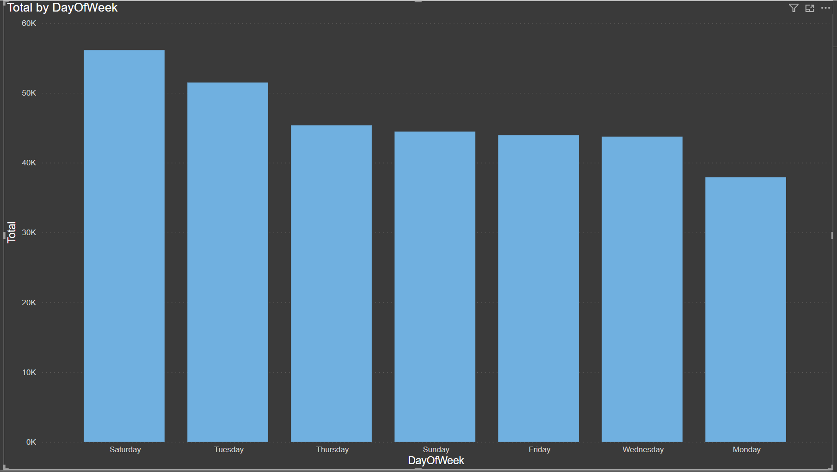
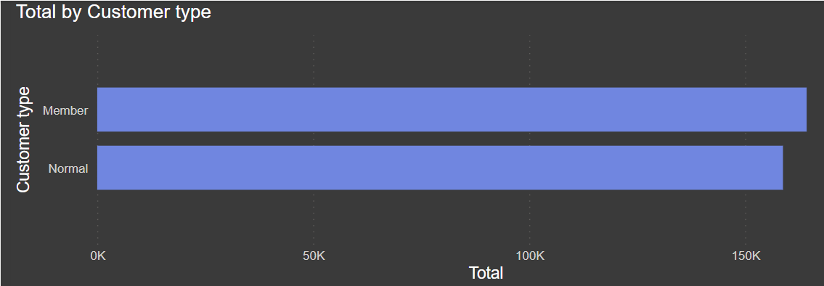
Time-Based Sales Trends
Sales peak during Saturdays are the busiest days for sales. The supermarket should plan extra staff and inventory for weekends.
Customer behavior analysis identified key patterns:
Members spend more on average ($327) compared to non-members ($318)
Sales peak during Saturday's

Slide 20
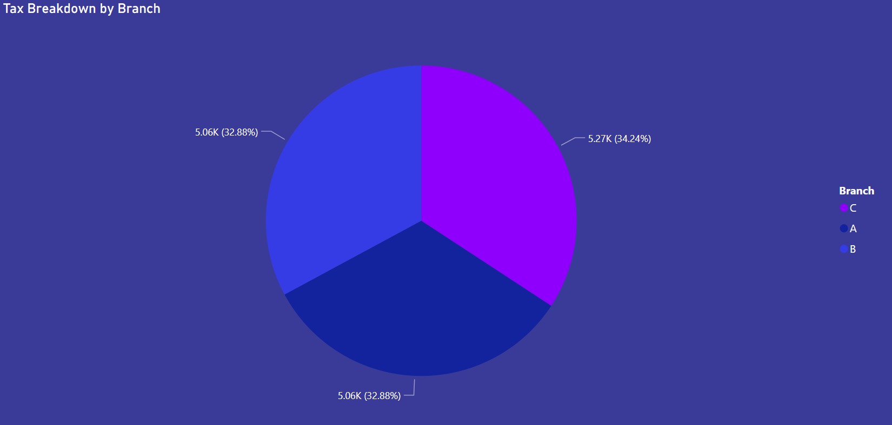
Tax Breakdown by Branch:
Presented as a pie chart, providing insights into the tax distribution among branches.
Branch C contributes the highest to tax revenue, highlighting strong sales performance.

Slide 21
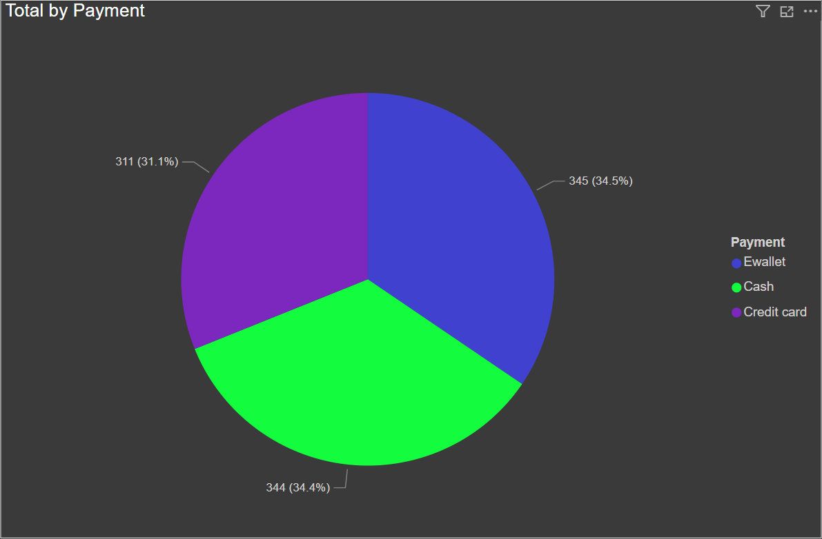
This pie chart shows most customers prefer E wallet and cash payments, but credit is also popular. Branch-specific trends can help improve payment systems​

Slide 22
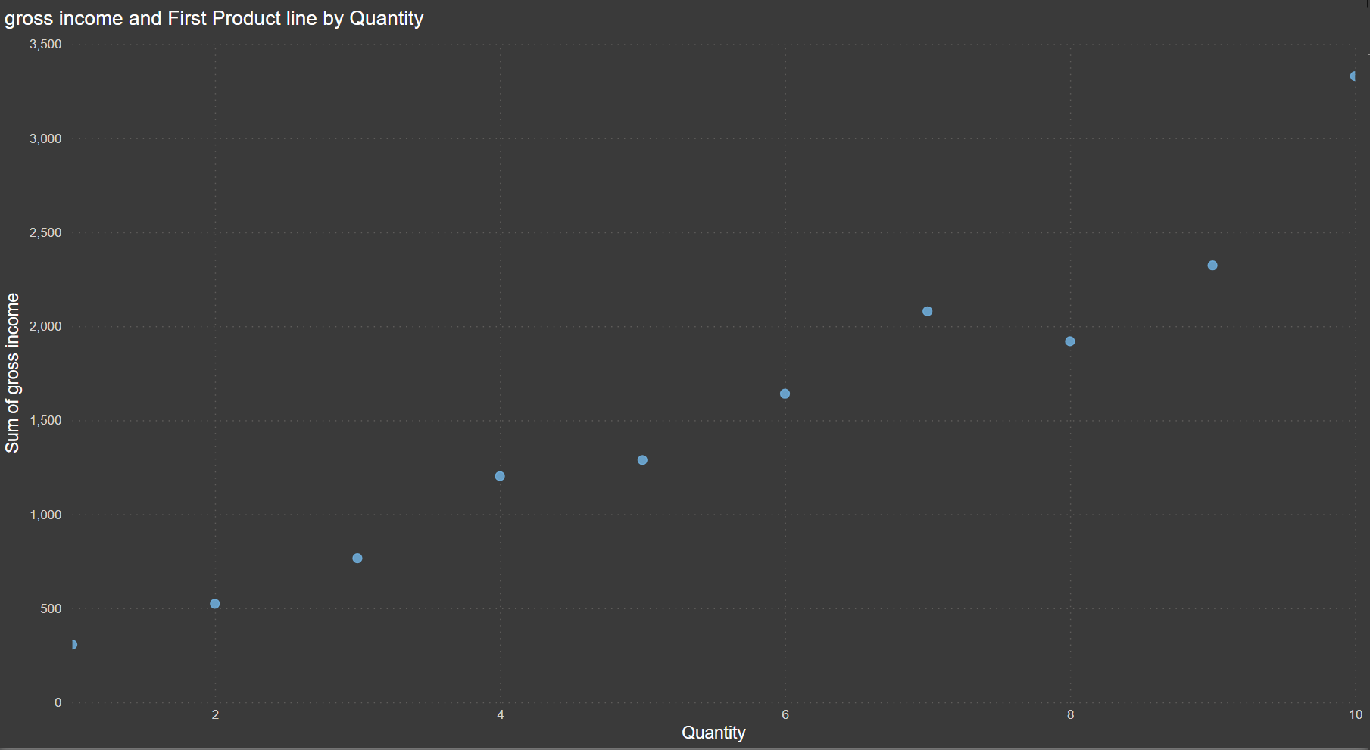
Profitability by quantity Quantity vs. Gross Income Relationship Between Quantity Sold and Gross Income
Higher quantities sold generally lead to higher gross income​
Some product lines with low quantity have high profitability​

Slide 23

Insights

Slide 24
Insights and Recommendations
The analysis provides the following insights and actionable recommendations
High-performing branches like Branch C should receive additional resources to sustain growth, Increase inventory and staffing to sustain peak performance
Targeted marketing campaign strategies should focus on member retention and increasing male customer spending to improve sales and customer satisfaction, create loyalty programs to keep members, since they spend more
Inventory optimization should prioritize popular product lines like Food and Beverages while addressing low-rated items and ensure consistent stock availability to meet high demand

Slide 25
Risks and Rewards
Risk: Insights may be limited by dataset size and scope.
Small Dataset: Only 1,000 rows, so it might not show everything about all branches.
Limited Scope: We didn’t look at other aspects like the economy or seasons that can change sales.
Implementation Issues: The changes we suggest need the management to agree and act on them.
Reward: Analysis provides actionable recommendations to improve revenue and operational efficiency.
Clear Insights: Shows how to improve branches, products, and customer satisfaction.
Better Resource Use: Helps focus on the best branches and products to save money and time.
Data-Driven Decisions: Managers and marketers can make smarter choices.
Can Be Expanded: This method can work for bigger datasets or more branches.

Slide 26
Conclusion The analytical solutions developed in this project enable data-driven decision-making, focusing on key areas of improvement for branch performance, customer behavior, and product profitability.
We provided a clear, actionable insights to help the supermarket improve its operations, customer satisfaction, and profitability. By focusing on top-performing branches like Branch C, retaining high-spending members, and improving low-rated products like Sports and Travel, the supermarket can make smarter decisions, with more data and continuous monitoring, the client can unlock even more opportunities for growth and success
Insights Summary
Branch C and Food and Beverages are key revenue drivers.
Food and Beverages bring the highest revenue, so they should always be stocked.
Members spend more than non-members. It’s important to focus on keeping members with loyalty programs.
Sports and Travel products have bad ratings and need improvements to make customers happy.
Sales peak on Saturdays, so the supermarket should plan better for weekends.

